Slide 1
Geografski informacioni sistemi domaći III
Branislav Jovičić, 1003

Slide 2
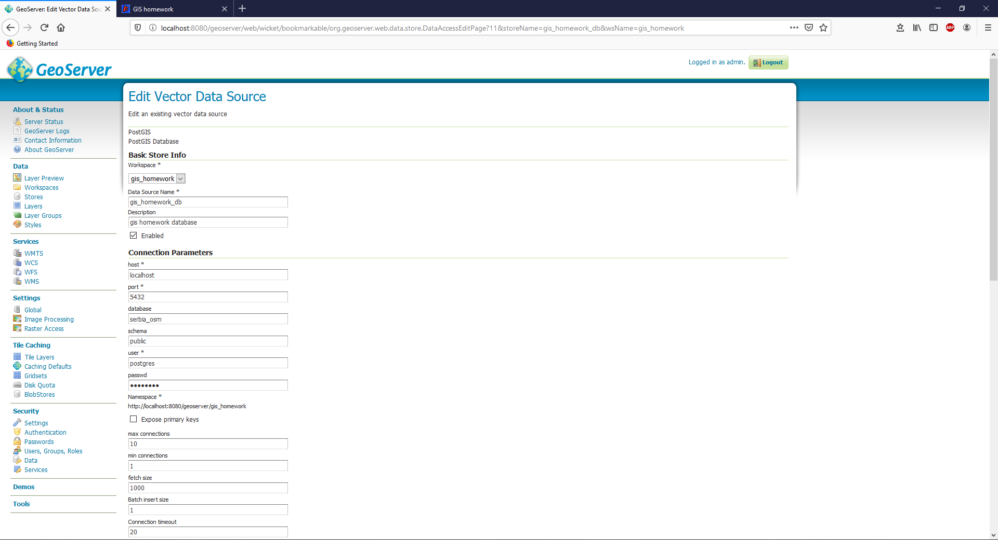
GeoServer store

Slide 3
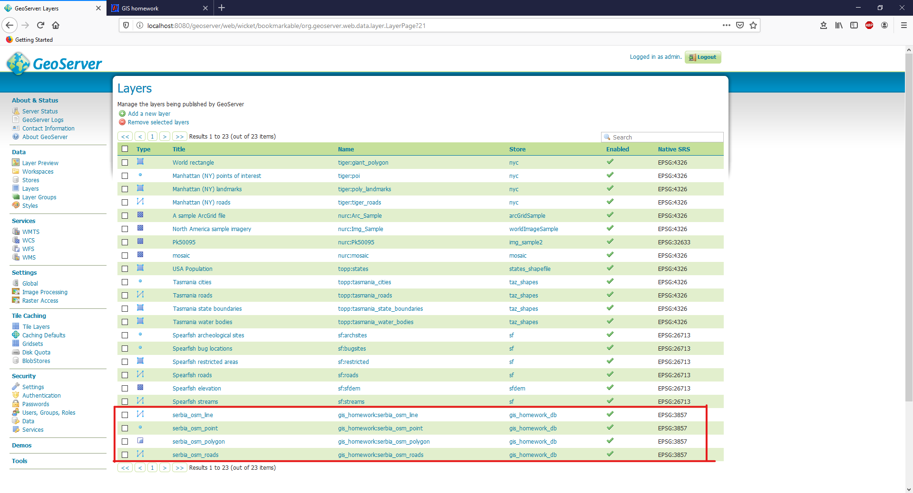
GeoServer slojevi

Slide 4
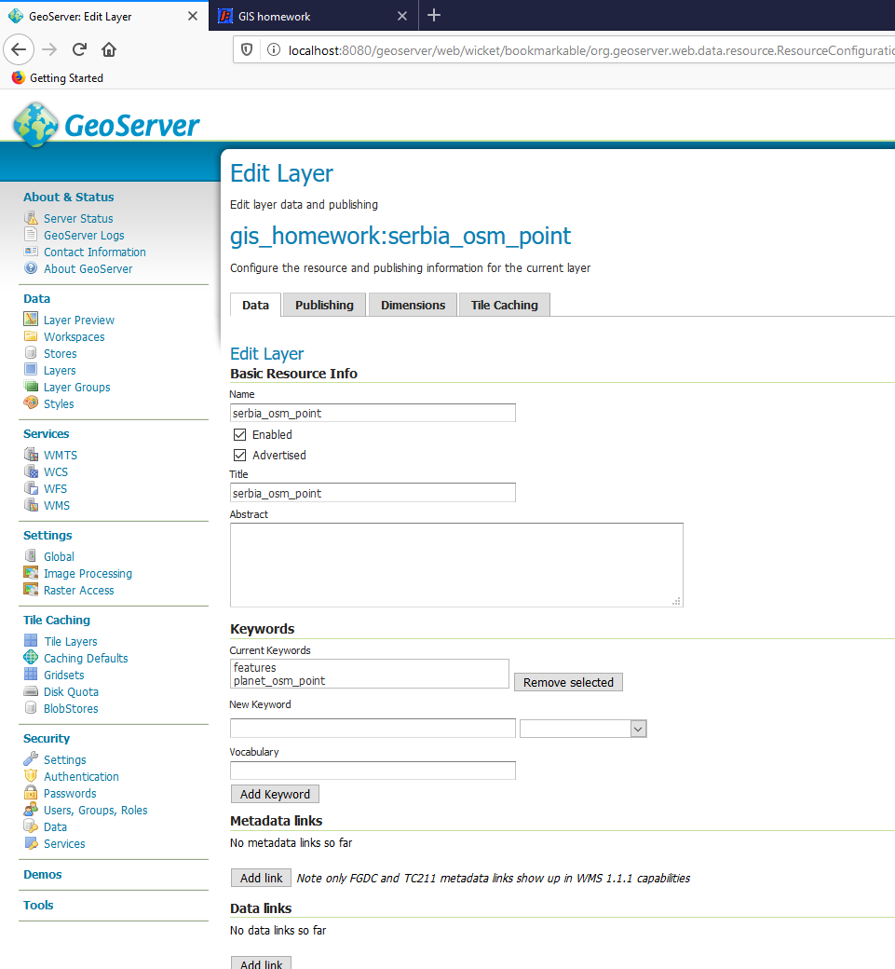
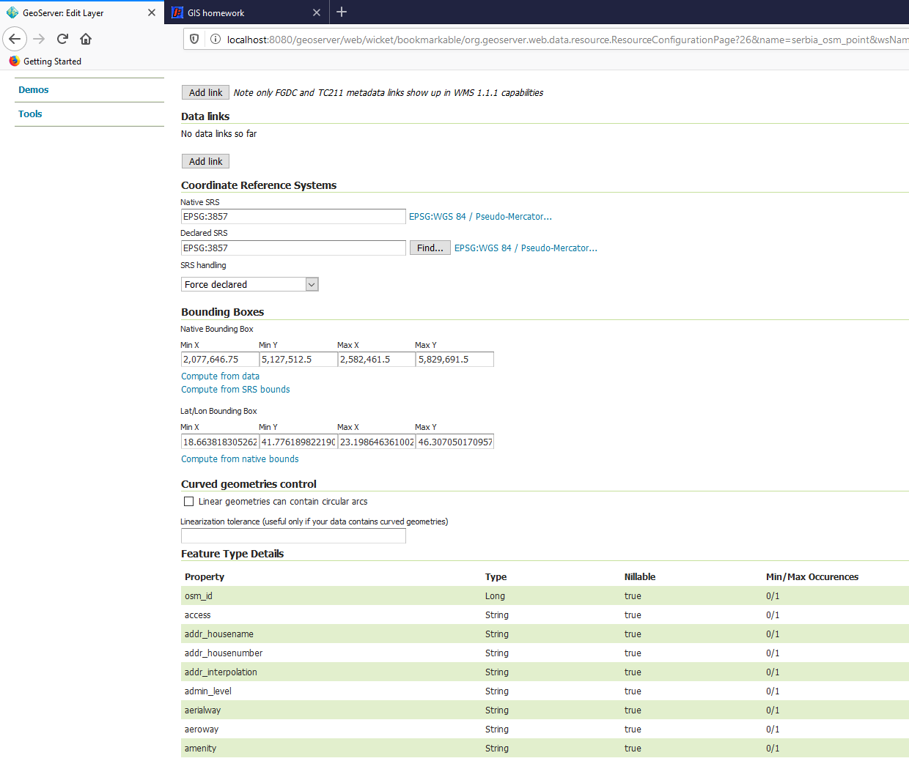
GeoServer slojevi - sloj serbia_osm_point

Slide 5
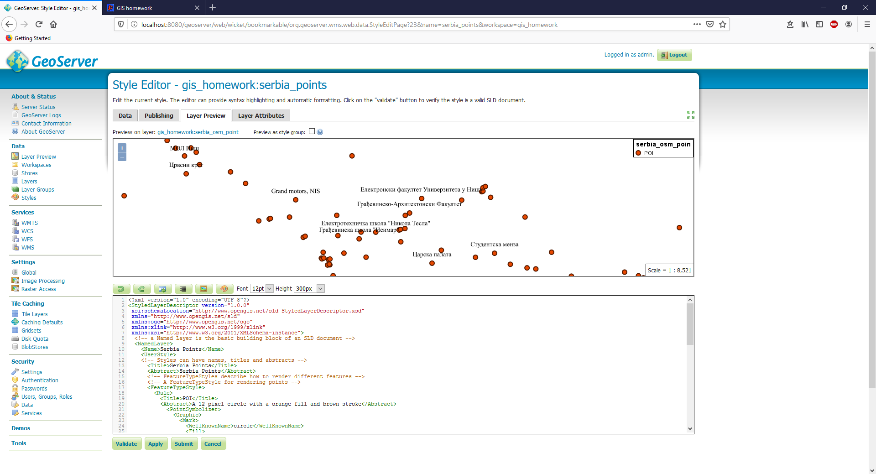
GeoServer slojevi - sloj serbia_osm_point sa pridruženim stilom serbia_points

Slide 6
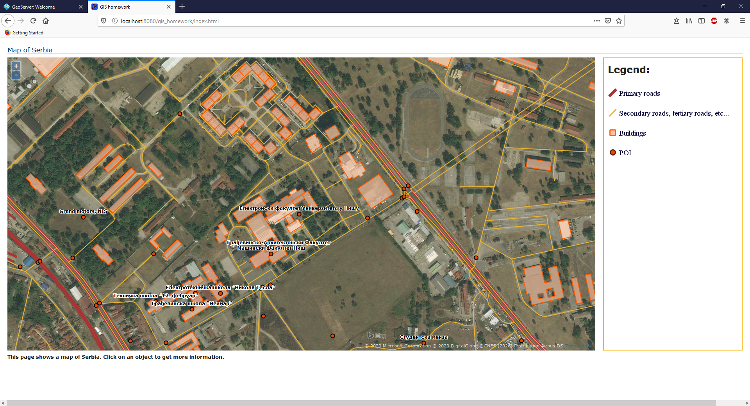
Web aplikacija

Slide 7
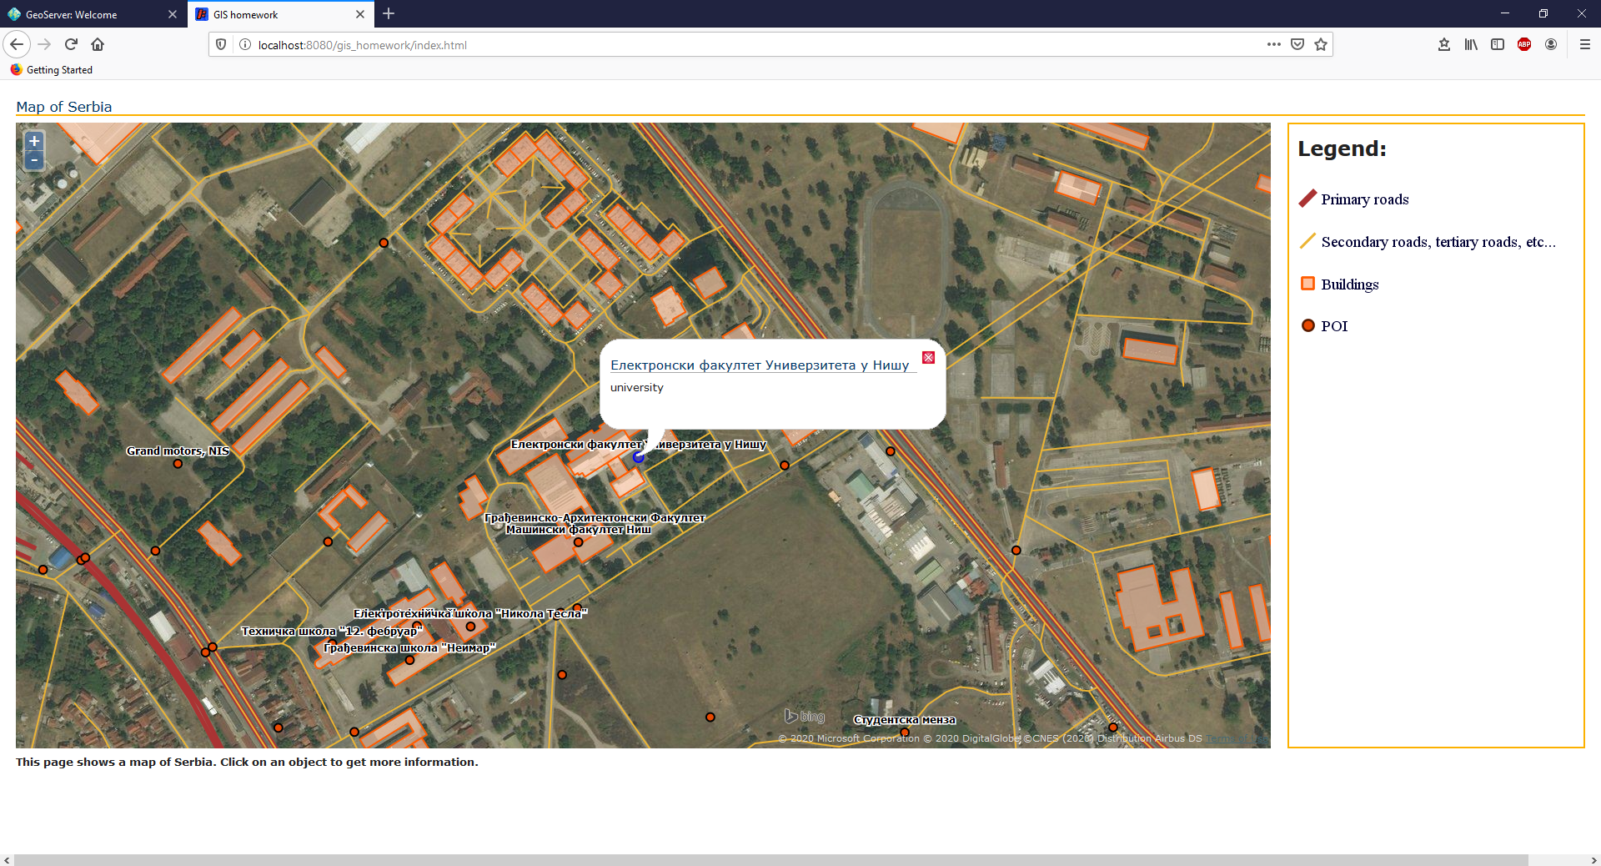
Web aplikacija - POI pop-up

Slide 8
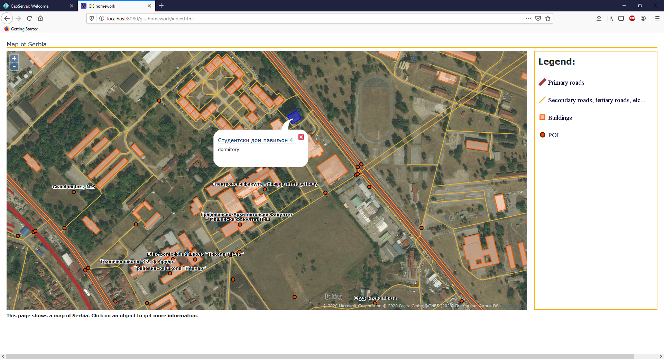
Web aplikacija - Buildings pop-up

Slide 9
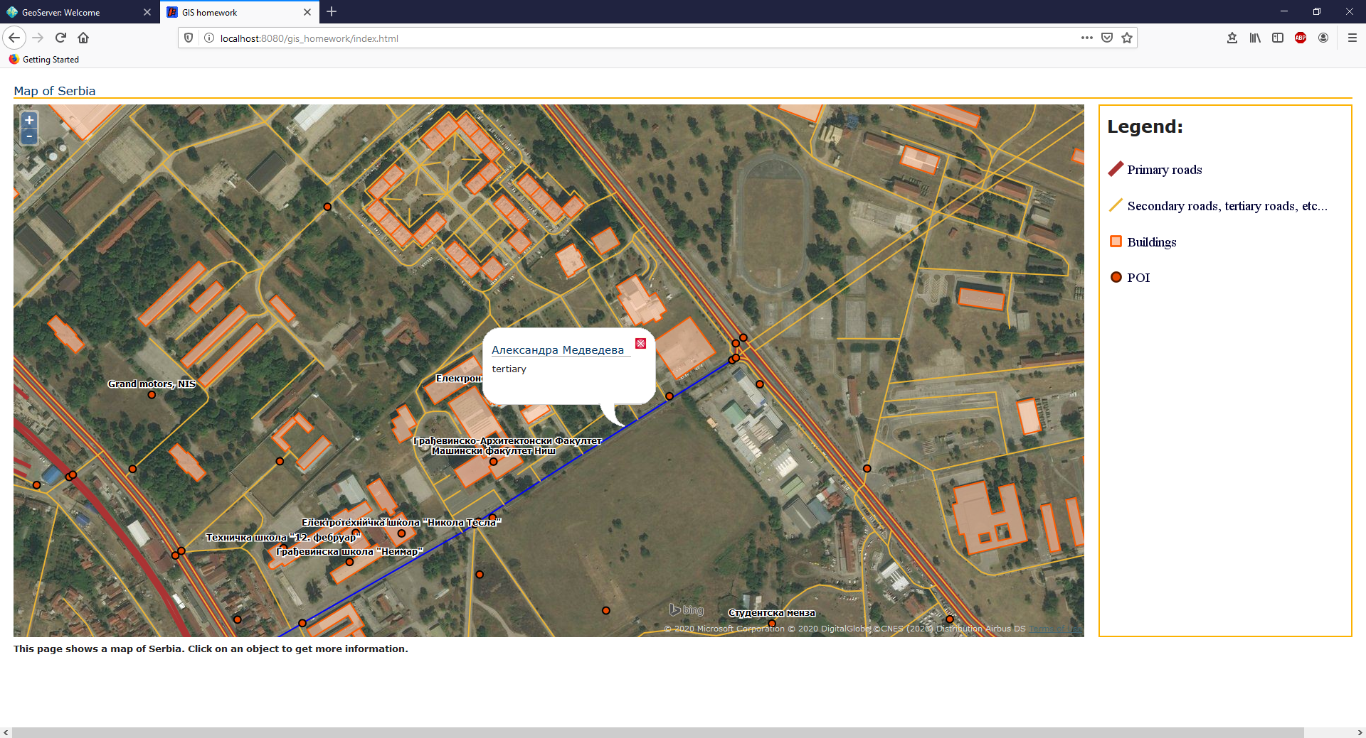
Web aplikacija - Tertiary roads pop-up

Slide 10
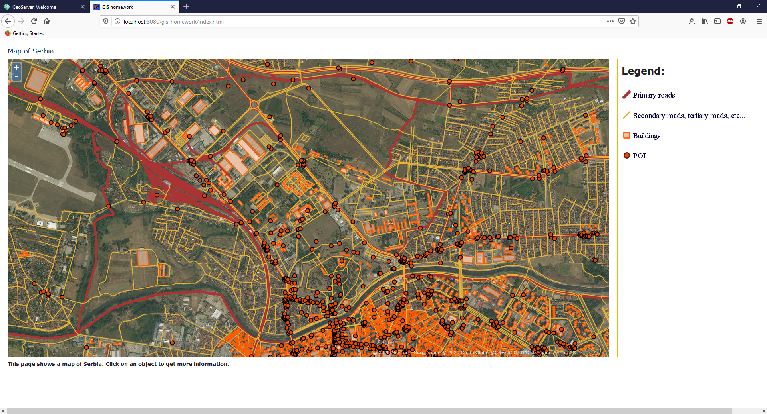
Web aplikacija - zoomed out

Slide 11
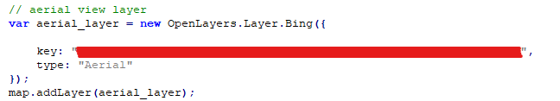
Aerial view sloj - WMS, Bing Maps

Slide 12
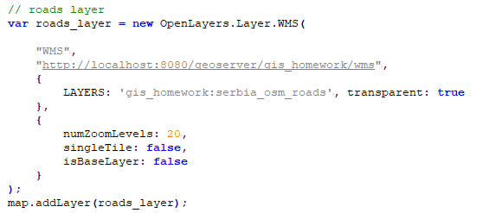
Primary roads sloj - WMS, GeoServer

Slide 13
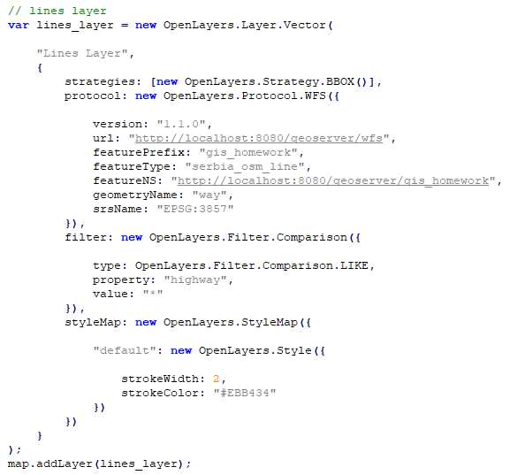
Secondary roads, tertiary roads, etc... sloj - WFS, GeoServer

Slide 14
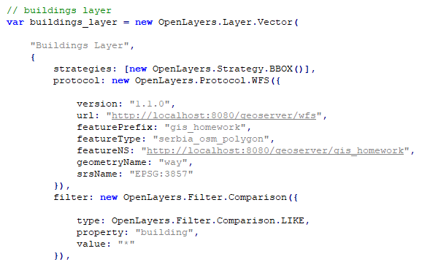
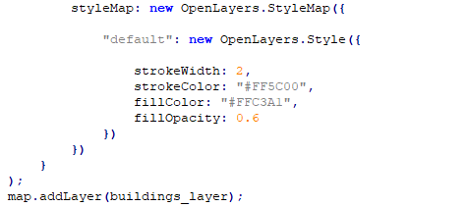
Buildings sloj - WFS, GeoServer

Slide 15
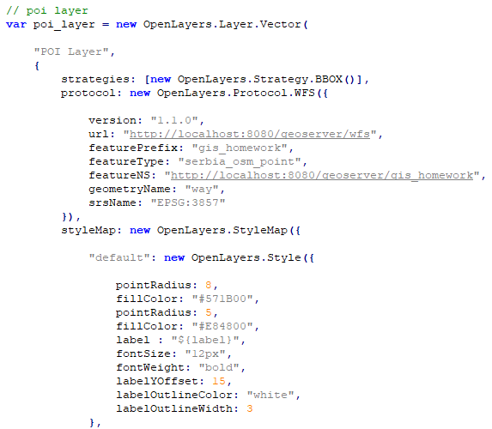
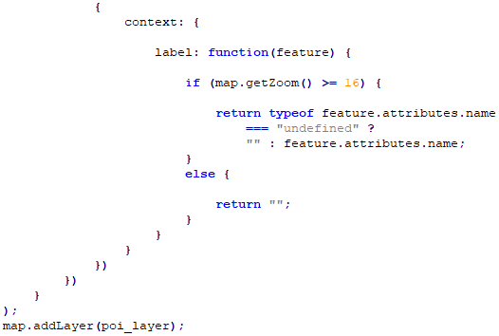
POI sloj - WFS, GeoServer

Slide 16
Legend - Primary roads
http://localhost:8080/geoserver/wms?REQUEST=GetLegendGraphic&VERSION=1.0.0&FORMAT=image/png&WIDTH=20&HEIGHT=20&LAYER=gis_homework:serbia_osm_roads&legend_options=forceLabels:on;fontName:Times%20New%20Roman;fontAntiAliasing:true;fontColor:0x000033;fontSize:14;bgColor:0xFFFFFF;dpi:120

Slide 17
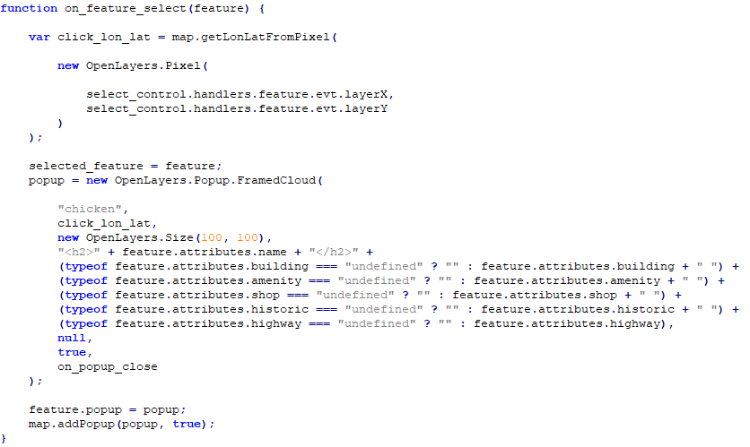
Pop-up

Slide 18
Geografski informacioni sistemi domaći III
Branislav Jovičić, 1003

